Slide 1
-past progressive-
-past continuous-
Galván Víctor
Osuna Fernando
Yescas Tania
IDGS 7-3

Slide 2
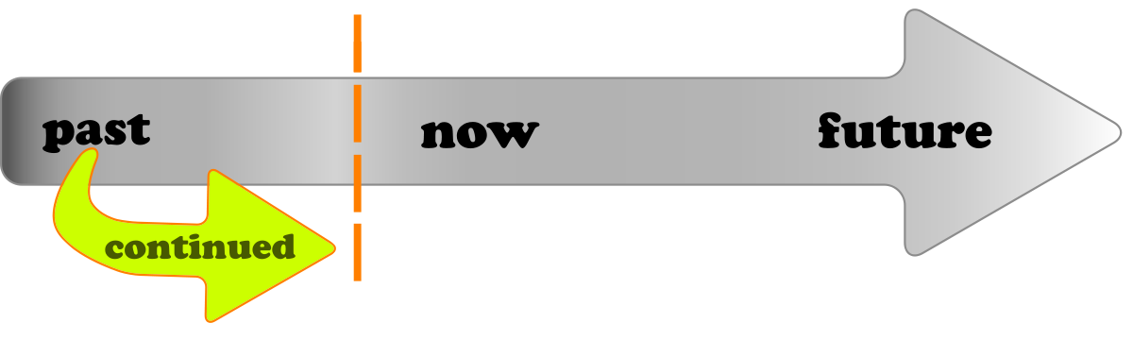
The past continuous:
The past continuous, also called past progressive, is used to refer to an action that was continuous at a particular time in the past.

Slide 3
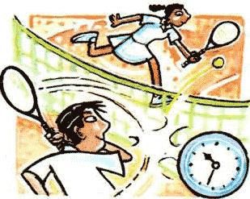
What is it?
Yesterday, Liza and Jim played tennis. They began at 10:00 and finished at 11:30.
So at 11:00, they were playing tennis.
They were playing="they were in the middle of playing." They had not finished yet.
Was/were playing is the past continuous.

Slide 4

Formula
The past continuous is formed as follows:
to be in the simple past + verb + ing

Slide 5
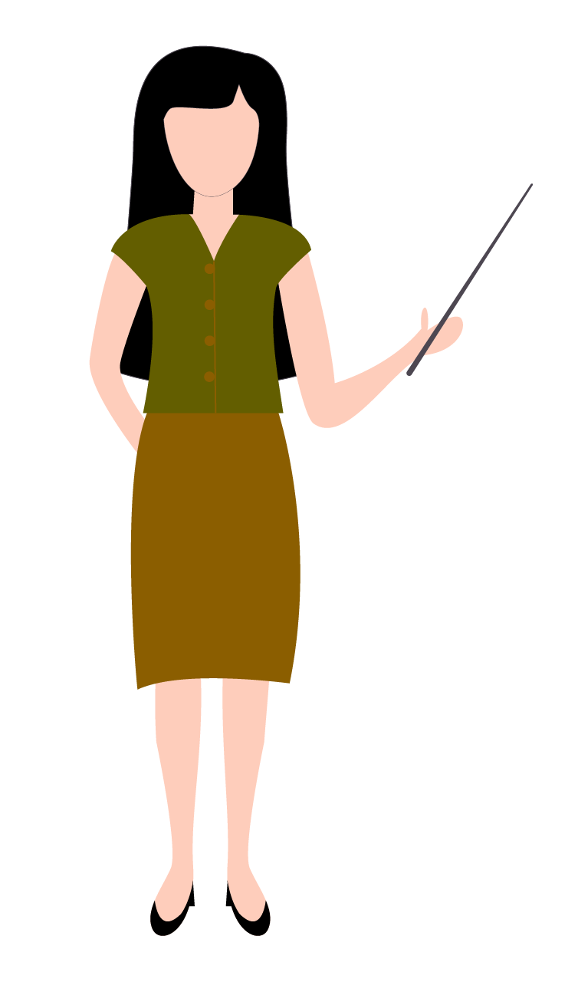

The affirmative form:
I, he, she, it | was | playing.
you, we, they | were | playing.
Yesterday evening I was watching a film, when someone knocked on the door.
This morning I was revising my lessons when my father came in.
Jim and Liza were playing tennis yesterday at 11:00.
My mom was hiding my dad’s gift when he arrived.

Slide 6
The negative form:
I, he, she, it | was not/wasn't | playing.
you, we, they | were not/weren't | playing.
I wasn't reading a book yesterday evening; I was watching a film.
My mother wasn't preparing dinner; she was working on the computer.
We weren't playing cards.
I wasn’t paying attention.

Slide 7
The interrogative form:
Was | I, he, she, it | playing?
Were | you, we, they | playing?
What were you doing yesterday evening?
And what was your mother doing?
Where were you going, this morning at 7:30?
What were Jim and Liza doing?

Slide 8
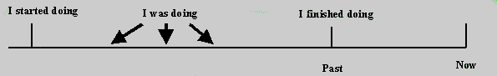
The use of the past continuous:
We use the past continuous to say that somebody was in the middle of doing something at a certain time in the past.
Example:
"This time yesterday, I was doing my homework."
We use the past continuous to say that something happened in the middle of something else:
Example:
"Bob burnt his hand when he was cooking dinner yesterday"
"While I was working in the garden, I hurt my back."

Slide 9
Conversation
-Hi good morning
-Hi, were you just finishing the book for this week?
-Yes, I was struggling this week because I didn’t have enough time to do it.
-It’s ok, you don’t have to worry, I was also reading the last part. I loved the end of the book.
-I know right. When the shark came out of nowhere!!!!!!
-The protagonist was running away so he wouldn’t die hahahaha.
-I also liked the part when they were driving in the night. So beautiful.

Slide 10
-Do you think that the group wasn’t fighting to get time to read?
-Probably. This week was battling for all of us.
-The finals exams are very close.
-Did you weren’t writing the last class of math?
-No, the class was so boring.
-I know, it’s like the teacher didn’t even knew what was he talking about.
-Anyway. What where you doing yesterday afternoon?
-Really? Did you just forget that we were presenting here at the classroom?
-Oh sorry. I was wondering why I couldn’t remember that.

Slide 11
-So what was happening that made you forget the presentation?
-It’s probably nothing, this week was making me feel really exhausted.

Slide 12


Slide 13
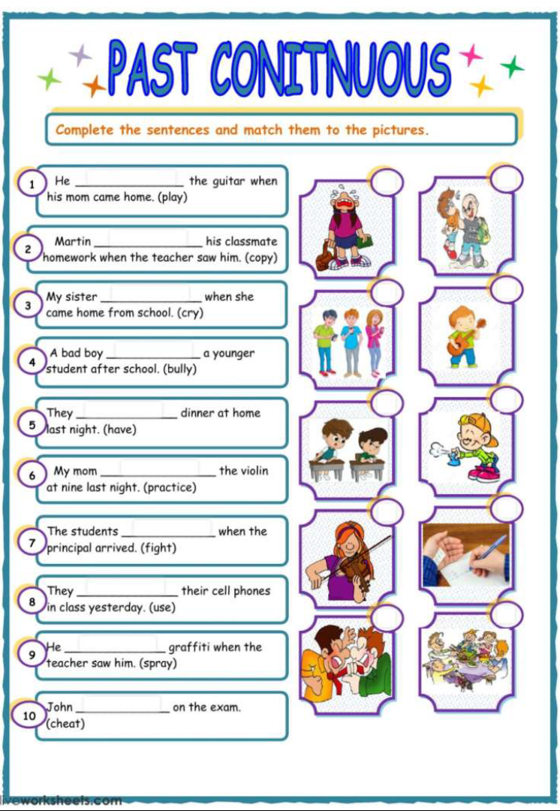

Slide 14
Q&a

Slide 15
They were presenting how past continuous works
thanks
for
your
attention

